Slide 1
Recognizing and Understanding Brain Injury
Peggy Reisher, MSW
Executive Director

Slide 2
BIA-NE Vision and Mission
Mission:
To create a better future for all Nebraskans through brain injury prevention, education, advocacy, and support.

Slide 3
Brain Injury 101

Slide 4
What is a brain injury?
Traumatic Brain Injury (TBI) An alteration in brain function, or other evidence of brain pathology, caused by an external force
Acquired Brain Injury An injury to the brain, which is not hereditary, congenital, degenerative, or induced by birth trauma- an injury to the brain that has occurred after birth
www.biausa.org

Slide 5
Interesting Comparisons

Slide 6
Brain injury Stats for Children
TBI is the leading cause of death and disability in children
More than half of TBI’s occur before age 25
On Average 475,000 TBI’s per year are experienced by American Children
Work in Denver identified 40% of those referred to special education had TBI.
Very few children with TBI are currently identified in schools, only 5% of children are predicted.

Slide 7
Why are they not identified?
Concussions go unnoticed
When noticed, lack follow up
Parents, teachers, and medical professionals fail to see the link between the blow to the head subsequent problems at school
School personnel are not adequately trained to identify or assess
It is confused with LD or ADHD

Slide 8
TBI and Criminality in Juvenile Offenders- Journal of Head Trauma Rehabilitation, 2017
Studies indicate the overall rate of TBI’s in the juvenile justice population is high. Studies vary from 32% to 72%
Despite high rates of TBI, most facilities don’t screen therefore injured offenders go undiagnosed, unrecognized, and untreated.
Most common causes are 1) Assault, 2) Falls, 3) Sports related injuries, 4) MV crashes
Adolescents with a TBI:
Commit more criminal offenses
Higher rates of conduct disorder and substance abuse
No specialized treatment was provided for the TBI

Slide 9
Brain Injury & Violence Domestic Violence
2016 project done by BIA-NE
60% of those screen, screened positive for brain injury
40% was hit or strangled 1-3 times
42% was hit or strangled 6 or more times
What about their children?
Studies have suggested the perpetrators are also likely to have a history of TBI

Slide 10
Why does this matter?
Brain injury can be an invisible injury, but a significant factor in functioning
This can be really scary
People may also be completely unaware
Effects of TBI can have a significant effect on responsiveness/utilization of resources
Small environmental supports can make a big difference

Slide 11
What This Might Look Like
Notes:
Could we put a video here?

Slide 12
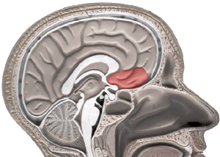
The skull
A protective covering
Bony protuberances in the bottom of the skull can scrape the brain
This part of the brain can be involved in:
Problem solving
Spontaneity
Memory
Language
Motivation
Judgment
Impulse control
Social and sexual behavior

Slide 13
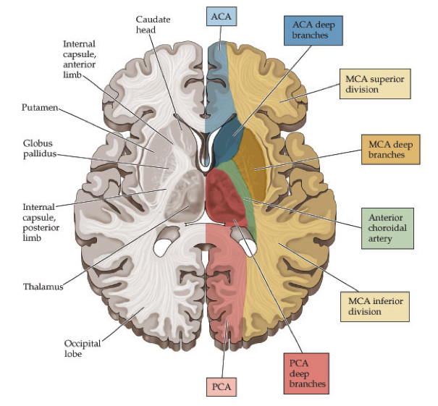
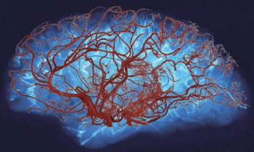
Oxygen deprivation
The brain’s blood supply
Hypoxic/Anoxic injury
3 major sets of arteries
Areas of overlap between arteries are most susceptible to oxygen deprivation

Slide 14
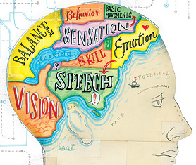
Generalized Core Functions by Lobe
Frontal | Temporal | Parietal | Occipital | Cerebellum
Attention | Language | Spatial Reasoning | Visual Processing | Control Process
Executive Fx | Memory | Sensory Perception |  | Motor
Behavior |  |  |  | Cognition
Emotion |  |  |  | Emotion
Motor |  |  |  | Error correction
Notes:
Each lobe has general functions for which it is responsible, but…

Slide 15
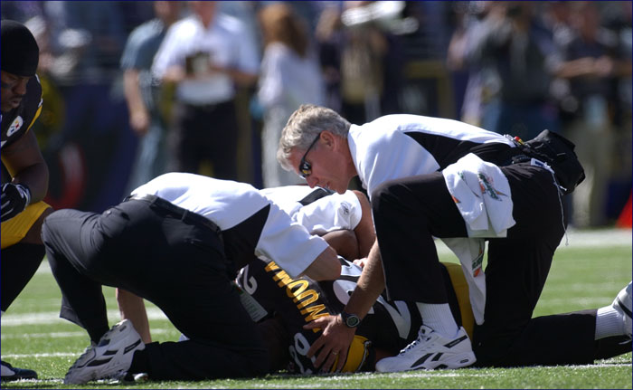
PTA and LOC
Loss of Consciousness (LOC)
occurs in less than 10% of mTBI/concussions
Post-traumatic amnesia (PTA)
Retrograde amnesia
Anterograde amnesia
injury
Notes:
Some research indicates that brief LOC does not reliably predict outcomes after mTBI
Longer LOC needs to be closely monitored

Slide 16
Recovery course for mild TBI
From 1 to 3 weeks to recover
80-90% recover in 1-4 weeks
10-20% will require more time
Younger children may require additional time to recover
Notes:
Premorbid factors affect recovery
Symptoms profiles may differ
Domains of functioning may come back on board at different times

Slide 17
Symptom Clusters
Physiological
Headache
Noise/light Sensitivity
Nausea
Fatigue
Cognitive
Concentration
Memory
Slow
Foggy
Cervical
Neck Pain
Headache
Numbness
Emotional
Irritable
Sadness
Anxiety
Moodiness
Balance
Dizziness
Imbalance
Clumsiness
Sleep
Falling asleep
Staying asleep
Drowsiness

Slide 18
Physical Changes
Injury related problem | How it may affect a person functionally….
Coordination | Unsteady gait, poor eye-hand coordination, slow or slurred speech, tremors, paralysis
Visual Deficits | Staring or poor eye contact, blurred or double vision, inability to follow an object with their eyes
Additional Physical Challenges: | Seizures, deaf or hard of hearing , fatigue

Slide 19
Changes in Cognitive Skills
Injury related problem | How it may affect a person functionally….
Memory | Trouble following directions, providing requested information, making appointments
Processing (receptive) | Understanding what being said, reading
Processing (expressive) | Trouble putting thoughts into words, tip of the tongue syndrome
Problem solving (related to frontal lobe & temporal tip Injury) | Impulsive, easily frustrated, sexually disinhibited, verbally/physically combative, interpersonally inflexible, poorly organized

Slide 20
Changes to Personality & Behavior
Injury related problem | How it may affect a person functionally….
Depression | Flat affect, lack of initiation, sadness, irritability
Unawareness | Unable to take social cues from others
Confabulation | “making up stories”
Perservation | Gets “stuck” on a topic of conversation or physical action
Anxiety | Can exacerbate other cognitive/behavioral problems

Slide 21
Risk factors for protracted recovery
ENVIROMENTAL STRESSORS
HISTORY OF HEADACHE
LD/ADHD
AGE
LOC/AMNESIA AT INJURY
PRE-EXISTING DPRESSION OR ANXIETY
MORE SEVERE SYMPTOMS IN ACUTE PHASE
BEHAVIORAL MISMANAGEMNT/ OVEREXERTION
FEMALE

Slide 22
Mental Health and TBI
Depression
PTSD
Anxiety
Suicidality
Substance/use abuse

Slide 23
Supporting individuals with brain injury

Slide 24
Attention, Concentration, & Focus
Simplify environment
Control noise and light
Provide clear visual prompts for environment
Provide clear structure and predictable routine
Remove any surprising/startling stimuli
Check-in for comprehension
Break larger tasks down
Make paperwork as simple as possible
Large font
Soft colored paper
Give breaks
Give few problems at one time
Shorten instructions
Provide quiet room to complete tasks
Notes:
These symptoms are common in kids with concussion
Here are some ways you can help.

Slide 25
Visual Processing
Assist in completing paperwork
Sunglasses inside
Provide soft lighting and a quiet place for relaxation
Assist with computer usage

Slide 26
Some adjustments for Learning and Memory
Write things down
Provide way for individuals to record information
Provide memory supports in the environment
Written and posted schedule/instructions; label cabinets/drawers/rooms
Shorten instructions
Present in with words and pictures
Model tasks
Checklists for chores/tasks
Check in for comprehension

Slide 27
Some adjustments for Processing Speed & Fluency
Complete paperwork in quiet, distraction-free room
Don’t put on the spot
Provide cues for time sensitive tasks
Create an environment that is conducive to asking for help and acknowledging any cognitive or emotional difficulties

Slide 28
Emotional/interpersonal difficulty
Communication should be direct, not subtle
Nonjudgement, noncritical, supportive feedback
Remain calm to reduce others’ agitation
Recognition that self-awareness and/or awareness of deficits may be low or nonexistent

Slide 29
Brain injury management
Profession | Expertise
PCP | health history; basic medicine
Neuropsychologist | cognitive function; brain/behavior relationship, behavioral treatment
Physical Therapist | “below the waist"; motor systems; balance
Occupational Therapist | "above the waist" adaptive behavior; functional assessment
Speech- Language Pathologist | speech and language assessment; language rehab including cognition related to language
Audiologist | vestibular system; auditory inputs
Psychologist | Therapy, sleep hygiene, anxiety management
Neurologist | brain structure and function; diagnose disease

Slide 30
Screening for brain injury

Slide 31
HELPS Brain Injury Screening Tool and Follow-up Questions
The HELPS screening tool can:
Assist you in identifying an individual who may have a brain injury and additional support
Be used as a script as you talk to someone about the possibility of a brain injury and learning if they need an accommodation, adaptation, or modification during their stay with us.
The HELPS screening tool is not a medical evaluation and does not provide a diagnosis. Any individuals identified should seek professional medical advice for any concern.

Slide 32
H- Have you ever had a hit to your head or been strangled or choked?
If yes, when was your head hit or when were you strangled or choked? Was it: (check all that apply)
Within the year?
1- 2 years ago?
3-4 years ago?
Longer than 4 years ago?
As a child?
Please describe how it happened. Did it happen:
Playing sports?
Riding a bike?
Were you wearing a helmet?
From a fall?
From an assault or fight?
Were you pushed, punched, shaken, or strangled?
In a car accident?
Did you receive whiplash or have a violent shaking of your head or neck?
From almost drowning?
Did you experience lack of oxygen for a significant amount of time?
Given the questions above, how many times had your head been hit or you were strangled?
1-3
4-6
More than 6

Slide 33
E- Were you ever seen in the emergency room, hospital, or by a doctor because of a hit to your head or because of strangulation or choking?
If yes, were you seen by a:
Doctor
Nurse
Other medical professional
Were you given follow-up recommendations?
Yes
No
Did you follow the recommendations?
Yes
No

Slide 34
L- Did you ever lose consciousness or experience a period of being dazed and confused because of a hit to the head or due to strangulation or choking?
If yes, for how long did you feel dazed or confused:
Hours
Days
Months
How many times have you felt this way:
1-3
4-6
More than 6

Slide 35
P-Do you experience any of these problems in your daily life because of a hit your head or due to strangulation or choking?
If yes, since the injury, have you experienced or are you experiencing: (mark all that apply)
Headaches?
Dizziness?
Nausea?
Sensitivity to light?
Blurred or double vision?
Numbness or weakness in any of your limbs?
Insomnia, difficulty sleeping, or changes in your sleeping patterns?
Feeling irritable or impatient?
Feeling anxiety or depression?
Confusion?
Difficulty remembering?
Difficulty concentrating or focusing?
Challenges with going back to school or work and performing the tasks you used to?
Do you think any of the problems are related to a head injury?
Yes
No
Uncertain

Slide 36
Where do we go from here?
Research
Awareness
Outreach
Education

Slide 37
Thank you!
Peggy Reisher, MSW
Executive Director
peggy@biane.org
402-890-0606

