Slide 1
Juvenile Service Definitions, Service Interpretive Guidelines & Standards of Practice within Probation
Melissa M. Koch, LIMHP
Juvenile Behavioral Health Specialist
Administrative Office of Probation
Notes:
Need to include a printed copy of the Juvenile Services Guide Book (careful of printing because alternating between portrait and landscape)
Lindsey to develop a participant workbook
Folders?

Slide 2
Objectives
Gain an Understanding of Juvenile Service Definitions and Service Interpretive Guidelines (SIGs) within Probation
Review Service Categories Treatment, Non-Treatment, Out of Home Placement and Additional Services
How to Apply Service Definitions and SIGs to Risk, Need, Responsivity (RNR) Principles of Juveniles
Gain knowledge of the Standards of Practice

Slide 3
History of the Service Definitions and Service Interpretative Guidelines
Juvenile Service Guide LB 561
Division of Behavioral Health - Lime Book
Medicaid Regulations
Notes:
Say: We did not change the SDs just to make changes. We as Probation decided that we needed to clarify some of the definitions, so they would be user friendly. They are more descriptive, more inclusive. We did not have a mechanism to determine if providers were meeting all the requirements for the service they were providing. They also are in line with Medicaid and the division of behavioral health definitions; this way, providers do not have to meet different expectations for different providers.
In probation, a group of individuals within the juvenile division and rehabilitative service unit assisted in writing the SDs and SIGS based on Medicaid and DBH. Many meetings and heated discussions occurred among licensed and non licensed staff.
During the development of these definitions, public comment was asked for on 2 different occasions for 60 and 90 days. There is a list serve of all the RSPs that would have received an email stating there was time for public comment. The Fee for Service Advisory Committee and NABHO NE association of behavioral health organizations also weighed in on the SDs and SIGS.
As changes came in, Diane Daly organized all the comments.

Slide 4
What are Service Definitions?
Description of services that an agency or provider will provide
Treatment
Non-Treatment
Out-of-home placement
Additional Probation District Services
Notes:
SAY: Why have these changed and how will these definitions help me in my day to day case management. These definitions are divided into categories, the actual is more descriptive and there are SIGs that explain when to use the specific SD.
Let’s take some time to discuss what Service Definitions and SIGs are. We will start with service definitions. Service definitions are a description of the a services that an agency or provider will be providing.
Service Definitions are divided into the same categories you are used to from the Juvenile Services Guide:
Treatment Services – those services that are recommended by registered treatment providers such as evaluations, hospitalization, outpatient, IOP, inpatient, TGH, MH, SU and CO
Non-Treatment – those services that a probation officer recommends such as IFP, independent living, JWP, Mediation, Wraparound
Out-of-home placement – this is also recommended by a probation officer or treatment provider. These are services like agency-based foster care or group home
Additional probation services – also recommended by a probation officer. Includes CAM and EM.
Each SD is divided into 12 areas. We will break this down and take a look at each of the areas.

Slide 5
Probation Service Definition – Service Name
Notes:
Service name – The name of the service

Slide 6
Probation Service Definition – Category
Notes:
Category: The type of classification for the service can fall under the major categories. This one falls under treatment/evaluations

Slide 7
Probation Service Definition - Setting
Notes:
SAY: Services can occur in a multitude of settings; Services can be provided in the client’s natural environment and/or other appropriate location(s); may include other appropriate community locations where the parent or caregiver is present including a foster home, school or other appropriate community locations conducive for the delivery of services. Services can be provided in a Professional Office Environment: i.e mental health center, substance use treatment center or private practice. Services can be provided in a Psychiatric hospital or general hospital with a psychiatric unit.

Slide 8
Probation Service Definition – Facility License
Notes:
SAY: The facility license shows any licensure that is required to provide the service. For example, this services licensure states as required by DHHS, Division of Public Health. The Division of Public Health brings together all the elements of public health within the Nebraska Department of Health and Human Services. This Division is responsible for preventive and community health programs and services. It is also responsible for the regulation and licensure of health-related professions and occupations, as well as the regulation and licensure of health care facilities and services.

Slide 9
Probation Service Definition – Service Description
Notes:
SAY: The service description explains what the service is and what outcome it is expected to provide.
A CO evaluation is a thorough clinical, strengths-based evaluation of a youth experiencing substance use/mental health symptoms. This evaluation must be completed prior to the initiation of any behavioral health services. The CO evaluation will determine a mental health/substance use disorder diagnoses, history of behaviors, trauma history/symptoms, criminogenic risk and risk of dangerousness to self and/or others, recommended behavioral health service(s) level and include the youth’s and family’s assessment of the situation. Based on the evaluation, appropriate behavioral health referrals will be provided.
Acute inpatient service for example is the most intensive level of psychiatric care. It is designed to provide medically necessary, intensive assessment, psychiatric treatment and support to stabilize youths who display acute psychiatric conditions. Typically, the youth poses a significant danger to self or others, or displays severe psychosocial dysfunction. Special intervention may include physical and mechanical restraint, seclusion and a locked unit. Services are provided in a 24-hour secure and protected, medically staffed and psychiatrically supervised treatment environment. 24 -hour skilled nursing care, daily medical care and a structured treatment milieu are required.

Slide 10
Probation Service Definition – Service Description
A CO evaluation is a thorough clinical, strengths-based evaluation of a youth experiencing substance use/mental health symptoms. This evaluation must be completed prior to the initiation of any behavioral health services. The CO evaluation will determine a mental health/substance use disorder diagnoses, history of behaviors, trauma history/symptoms, criminogenic risk and risk of dangerousness to self and/or others, recommended behavioral health service(s) level and include the youth’s and family’s assessment of the situation. Based on the evaluation, appropriate behavioral health referrals will be provided.
Notes:
SAY: If we look at the service description for a co-occurring evaluation you see in green it describes what the service is and then in purple it shows what the expected outcomes are.

Slide 11
Probation Service Definition – Service Description
Acute inpatient service is the most intensive level of psychiatric care. It is designed to provide medically necessary, intensive assessment, psychiatric treatment and support to stabilize youths who display acute psychiatric conditions. Typically, the youth poses a significant danger to self or others, or displays severe psychosocial dysfunction. Special intervention may include physical and mechanical restraint, seclusion and a locked unit. Services are provided in a 24-hour secure and protected, medically staffed and psychiatrically supervised treatment environment. 24 -hour skilled nursing care, daily medical care and a structured treatment milieu are required.
Notes:
SAY: Let’s take a look at another example. If we look at the service description for acute inpatient service you again see in green it describes what the service is and then in purple it shows what the expected outcomes are.

Slide 12
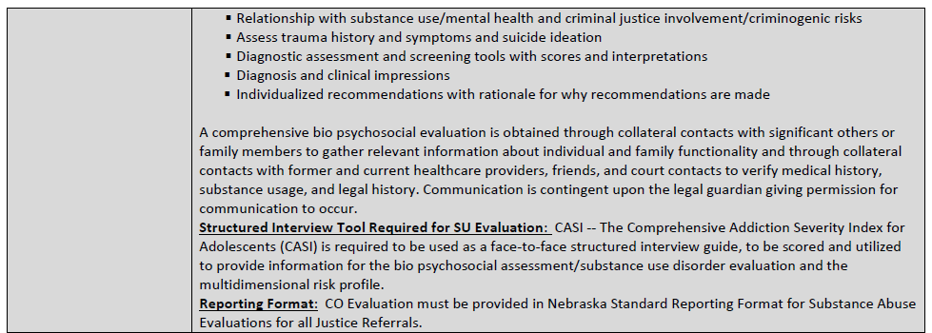
Probation Service Definition – Service Expectations
Notes:
SAY: Each service definition has a service expectations section, which provides a more detailed description of the service. This gets us into the meat and potatoes of the service definitions. The Officer is the first line of QA, so this provides you with a description of what should be happening in the services. This is what you should be seeing when you have youth in the services. These are minimal expectations.
Example TxGH---as an officer, I see that family therapy is to occur 2 times a month. I see on the voucher notes or the family tells me they have not attended any family therapy or groups, what do I do? First contact the provider and ask why---use the SD as a talking point, each provider has the SDs. If this does not rectify the situation, please follow your districts protocol which might be JJRS, your supervisors, or a TX officer. Use admin after you have engaged your district process. Admin will ask you what you have done, please document all your efforts to rectify, as this assists with performance plans, removal as providers.
This would include areas of assessment, depending on the service, components of the actual service, including treatment and discharge plans, this section tells POs where the services should take place, who the service is utilized for, and discussion of what the agency staff need to do.
You can use the service expectations to compare the services to see what services are most appropriate for case management purposes. For instance, if you have MST services, then you may not need other services such as tracker and FSW. If a youth has FSW, tracker and EM these services may all be doing the same thing. The Officer needs to look at the service definitions to see what services are most useful for the particular youth.

Slide 13
Probation Service Definition – Service Frequency
Notes:
SAY: Service Frequency is how often the service shall occur. This also is the first line of QA for the PO. Officers need to know how often the service will occur for the youth.
If services are not occurring at the right frequency, please check into the why, like we just discussed. We need to consider the principle of Dosage when we are not seeing the intended outcomes we were hoping for.
ASK: What do you remember regarding applying the dosage principle to a service?
Expected responses: intensity and service frequency needs to match the level of risk for the client. High risk, we would see high service frequency and intensity of the service. If lower risk, then less frequency and less intensity.
If service providers are asking for a service to go above the recommended service frequency or length of stay, then it is important for us as officers to reassess for risk level. If risk is elevating and intended goals and outcomes are not being met, could it be over-dosing? Providers may have a good reason for increasing or decreasing service frequency, but it needs to be communicated. If it is not documented, it did not happen. This goes for providers, agencies, probation officers and admin.

Slide 14
Probation Service Definition – Length of Stay
Notes:
SAY: The length of stay is the average length of time the service shall last. The length of stay depends on the service. It is important officers be aware of how long the services should last.
Similar to service frequency, if the length of the services do not fit the SDs, then check with the provider. Again, there may be a reason, but it must be communicated and documented.
We have examples of providers requesting extended length of stay in PRTF with little justification for the reason behind needing to continue that intense level of treatment. Are we over-dosing?
ASK: What is the definition of insanity? Doing the same thing over and over and expecting different results. We need to find out why it is not working! Is it dosage? Responsivity? Is risk lowered? Etc.

Slide 15
Probation Service Definition - Staffing
Notes:
SAY: Staffing tells us what requirements the staff must meet to provide the service. In this example, it shows the credentials that are needed to provide the service. Officers need to be aware if the staff are licensed to do the service.

Slide 16
Probation Service Definition – Staff to Client Ratio
Notes:
SAY: Staff to client ratio explains the requirement for staff to client for each service.
Overnight adult and juvenile
Awake or not awake
2 staff for IOP if 24 no---need to follow staffing

Slide 17
Probation Service Definition – Hours of Operation
Notes:
SAY: Hours of operation tells us what hours the services are provided and if they accommodate the youth and family’s needs.
We can not mandate that staff be available after 5pm, but if you need providers for families after 5pm, you can have the youth and family go elsewhere.

Slide 18
Probation Service Definition – Service Desired Outcomes
Notes:
SAY: Service desired outcome is a quick run down of what the service will have as an outcome.
Probation’s rate sheet is posted on the intranet for you to reference or find. We will look at this a bit.

Slide 19
Probation Service Definition – Unit and Rate
Notes:
SAY: The rate is the rate of reimbursement for the service. Exceptions for rates need to be granted from admin; they should not negotiated at the district level.
Probation’s rate sheet is posted on the intranet for you to reference or find. We will look at this a bit.

Slide 20
What are SIGs?
Service Interpretive Guidelines
Recap of the service definition
Expectation/requirements section
Guideline for when the service should be used
Notes:
SAY: Service Interpretive Guidelines have two categories. They are a recap of the service definition, as well as an expectation/requirement. The expectation/requirement provides guidance on when and with whom that level of service should be implemented. It assists in targeting the service to the appropriate youth. These new tools will be an asset for all of us when case managing with our clients.
The SIGs are for officers to have a more concise understating of the SDs. If there are still questions, refer to the SDs.
Providers do have access to the SIGs, but they were written more for the POs. The interpretive guides helps us as PO’s understanding the service expectations, how the service is best utilized, and how it should be used. If we are asking for a service to take place, we as officers have a responsibility to understand the service, how it is being used, and what the intended goal is for the service. The SIG’s also help us know our role, and supervisors will make sure the PO understands the reason for the service and intended outcomes. And, the JJRS will want to know why the service, what is the goal of the service, if going beyond the service frequency why? Supervisors and JJRS’s may also ask you to re-assess for risk or relook at responsivity factors if a service is not meeting the intended goal.

Slide 21
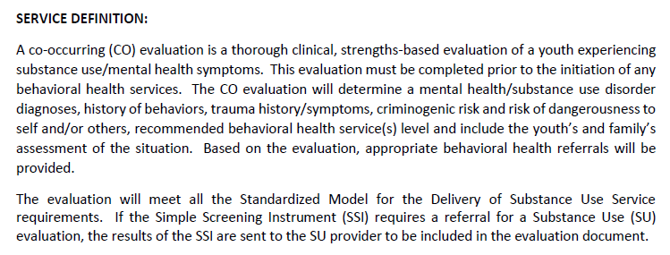
Service Interpretive Guidelines
Notes:
SAY: Here is an example of a service definition from the SIG. Notice this definition states that this type of service would be appropriate for youth who are experiencing substance use/mental health symptoms.

Slide 22
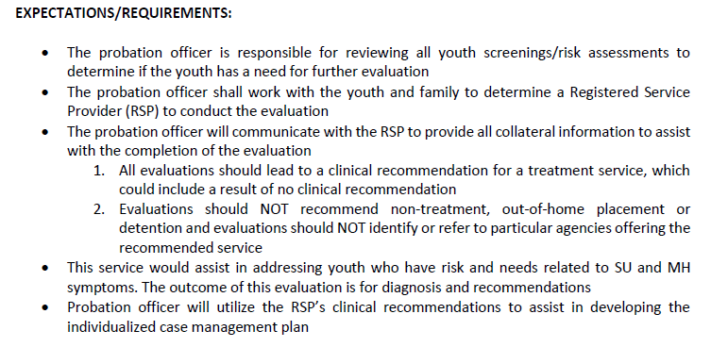
Service Interpretive Guidelines
Notes:
Trainers: we should be 45 minutes into the training
SAY: Here are the expectations/requirements. It lists out what probation officer’s role is in this service. It helps to define the role of the probation officer, so you know what you are responsible for. We are reiterating that all officers need to review all screening and risk assessments. We then need to work to identify the registered service provider, communicate with the provider, and use the clinical recommendations to assist in developing the case plan for the youth. Clinical providers evaluate clinical need and make treatment recommendations. Probation Officers evaluate criminogenic risk/need using the YLS and other screens to make recommendations for interventions to address the high risk areas. We integrate the treatment recommendation into the case plan, the treatment recommendations are not the case plan.

Slide 23
Who?
Probation Staff
Judges & Court Personnel
Registered Service Providers
QCRs
Family
Notes:
Large group Discussion who needs to know about SD, SIGS and Standard of Practice
TRAINER: Ask question below and then answers fade in with clicks.
ASK: Now that you know what service definitions and SIGs are, who do you think needs to know about them?
Expected Response: Probation Staff – Officers, Chiefs, Chief Deputies, JJRS, Supervisors, Placement Coordinators, Intake Coordinators
Judges & Court Personnel – County Attorneys, Defense Attorneys, GALs
Registered Service Providers – Providers & their staff
QCRs
Family
SAY: They all need to know SD and SIGs, so clients are receiving appropriate services based on risk-need-responsivity from the YLS scores and other assessments. Service Providers need to know about SDs and SIGs, so they know that the client’s needs are based on assessments and that these are the areas Probation is expecting the service to target. This will help in creating the comprehensive case plan for our youth.
ASK: What is an officers role in using SD and SIG’s
Expected response: We need to understand the service, the intensity of the service, dosage recommendation, what domains it targets, what the expected outcome is, how long the service is expected to reduce risk, what responsivity factors are we incorporating

Slide 24
Why?
Guide expectations for service delivery
Consistency among services providers & utilization of services
Quality Improvement and/or Quality Assurance
Fiscal responsibility
Notes:
TRAINERS: Say information below and generate a discussion around why. The answers will fade in as you click.
SAY: Now that you know what SD and SIGs are, let’s talk about why we need to have them. Previously, we had the juvenile services guide, which provided information on services that were available to youth on probation. SDs and SIGs are replacing that document. They are more detailed definitions and expectations or requirements of the services. They give the Officer more information on what their responsibility is, as it relates to each service. Service expectations vary depending on the type of service, why the referral was made, if the service is for supervision or for treatment purposes, if court ordered what is the question the judge is asking.
Probation will have the same expectations from each of the providers, no matter where they are located. For example, providers in Omaha will be held to the same standards as providers in Scottsbluff. A tracker in McCook is the same as a tracker in Norfolk. It sets an expectation for consistency across the board.
It will ensure matching services to youth’s needs. As you saw in the SIGs example, it gives an example of the risk domains that the service can target. This relates to EBP. We need to assess the youth’s risk using our validated risk assessments, in order to know what areas we need to target. Using our SDs and SIGs, it will guide our recommendations and ensure they are targeted at the youth’s high risk domains.
These SIGs and SDs also ensure that non-treatment services recommendations are made by the officer, not by clinicians. Treatment recommendations are made by the providers after an evaluation is completed. The SIGs and SDs help hold service providers accountable to assist probation in holding service providers accountable.

Slide 25
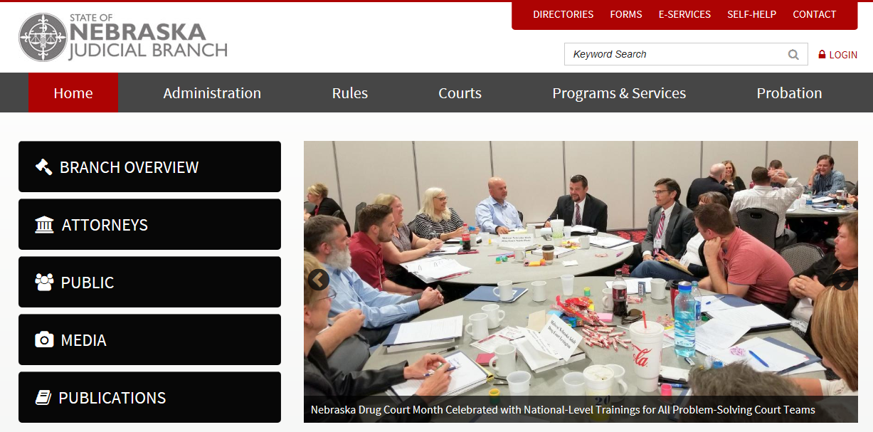
Where do find these sources?

Slide 27
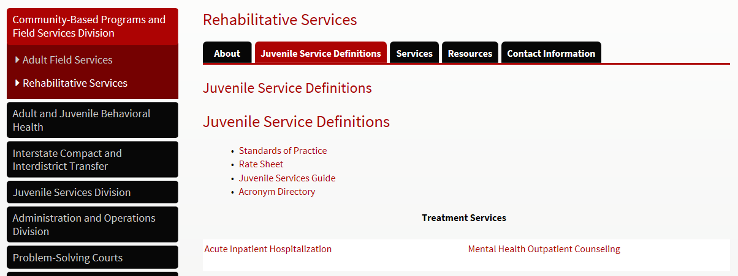
Click here to print the full service definitions
Notes:
This is were they can print out the entire guide book full of the service definitions. Also, you will notice the rate sheet listed that tells us how much

Slide 28
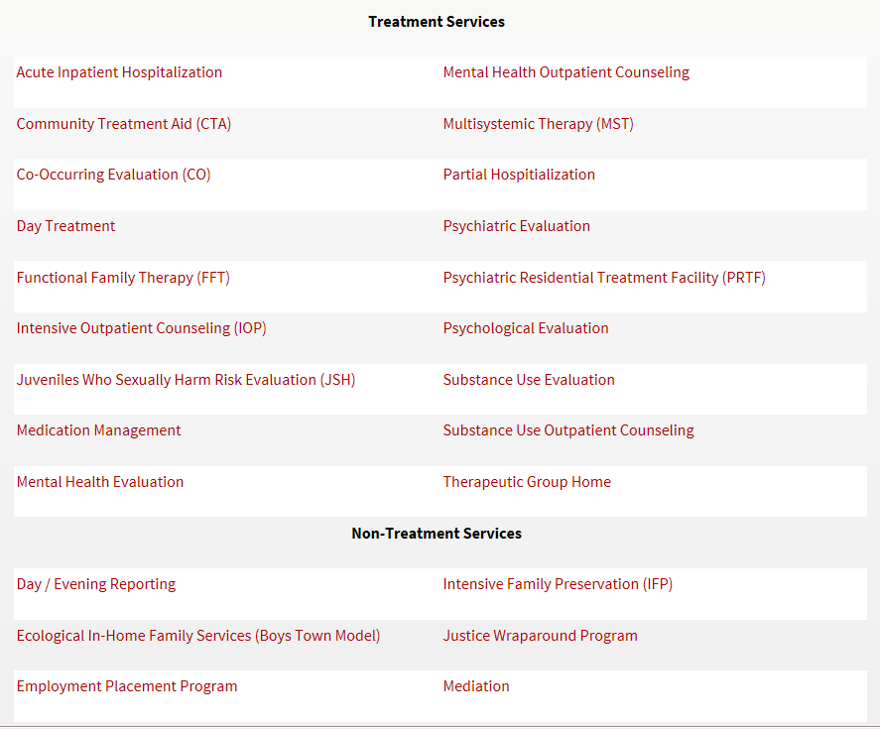
You can also click on each of the services individually to view their definition
Notes:
These will print individually for your use.

Slide 29
Service Categories
Treatment
Non-Treatment
Out-of-home placement
Additional Probation District Services
Notes:
SAY: There are four service categories, the same as the previous juvenile services guide.
Activity:
Trainers, we can make this a game between table groups. Provide each of them the categories of services, and then all the services. Have the table groups put the services under the correct category. Time it.
Key Trainer Notes:
Treatment : Involves a treatment service and an evaluation and is recommended by clinicians
Non-treatment: Referred by us Probation
Can a probation officer make or implement non treatment recs? Yes they are the only ones who can. This is part of RCMS responsive case management standards. What we are doing as officer is part of RCMs (this is already what we need to be doing) (home visits, contact with the school, groups (cog restricting, T for C, MRT) team meetings). do we need a tracker if I as the probation officers are to be in the home. No we may not-----
Out-of-home placements
Probation officers make the recommendations to the court about the need for an out of home placement and recommend the intensity necessary to meet the assessed risk/need. Group home A and B is never a treatment placement. The only TX out of home services are TxGH and PRTF
If a youth is placed out of home, the environment needs to be the least restrictive, the placement needs to be short term and a re entry or discharge plan needs to be established at the beginning of the placement. Placements do not need to be consecutive or a step process. Probation officers need to continue to engage the family and youth during any out of home placement. As a reminder these are the out of home placements
TX
Acute Hospitalization
PRTF
TxGH
Non TX
Group home A and B
Agency Based Foster Care
Crisis Stabilization
Additional Probation District services
Are also recommended by PO based on risk and need. These also should be short term. What are some of the these services CAM and EM?
EM is seen as a detention alternative EM restricts a youth’s liberties---this is highly restrictive service not to be utilized for extended period of time—it is short term.
Say: When do you use CAM? Say: What other strategies have you as an officer utilized beside CAM?
This is utilized when a youth can not abstain from alcohol when using CAM the youth needs to be involved in alcohol treatment.

Slide 30
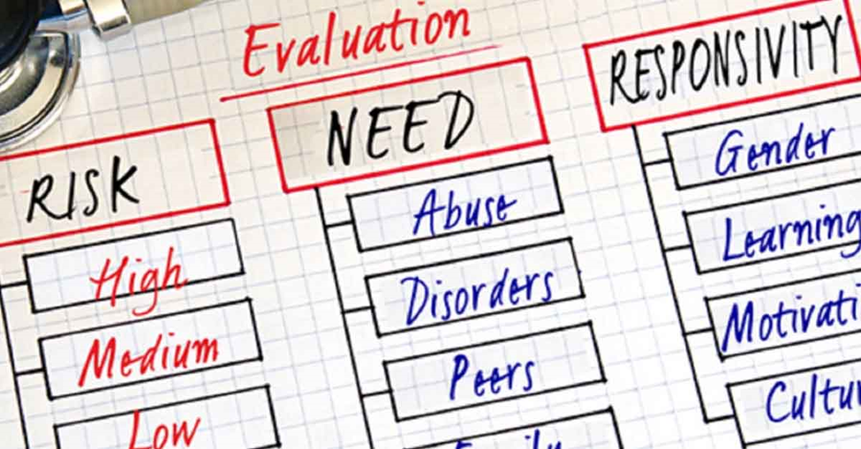
Risk, Need and Responsivity
How do officers use the Service Definitions, Service Interpretative Guidelines in their case management.

Slide 31
How do SDs Relate to Risk Need and Responsivity ?
Risk
Need
Responsivity
Dosage
Treatment
Who should we target?
Prioritize treatment resources and services for higher risk youth
What should we target?
Target interventions to criminogenic needs
How should we do it?
Be responsive to temperament, learning style, motivation, gender, trauma, mental health, and culture
How much?
Structure 40% to 70% of time for 3 to 9 months for high risk youth
How well?
Integrate treatment into the case plan with proven methods and evaluates effectiveness
Notes:
Say: How do SDs relate to Risk, Need and Responsivity?
We all are familiar with RNR principles and how they relate to targeting criminogenic risks and needs. But, there are two other key components relating to RNR that are Dosage and Treatment.
RISK: We know the risk principle answers the “who” should we target. Risk Principle tells us to reserve our most intensive interventions and supervision for our higher risk youth. Intensive interventions for lower risk youth can actually increase recidivism.
NEED: The need principle tells us that by assessing and targeting criminogenic needs for change can reduce the probability of reduction of recidivism. Criminogenic needs include: Antisocial attitudes, antisocial friends, substance use, impulsive behavior. Non-criminogenic is not linked to criminal behavior include: anxiety, low self esteem, medical needs
RESPONSIVITY: How are we going to implement the interventions taking into consider the youth’s individual learning style, temperament, ethnicity, cultural, neighborhood, trauma, etc.
Dosage includes involves helping the youth and family find ways to structure the youth’s time around positive prosocial activities that support behavior change. We can do this by looking to the youth’s strengths and things the youth enjoys doing. The dosage principles also helps us to tap into other on-going supports with mentors or other role models that the youth may have or develop in their life that can continue to be that positive on-going support long after the youth and family are no longer involved in probation.
Depending on the youth’s risk will help us determine how much of the youth’s free time needs to be filled with activities to support change. So, the risk principle says we prioritize treatment and interventions for the higher risk youth, more structure needs to be implemented to support positive attempts at behavior change. Allowing the youth and family voice and building on strengths and sparks, this is a way to fulfill the dosage principle. Dosage relates to the SD’s to frequency, length of stay
ASK: How does the treatment principle relate to RNR and SD?
When applying the treatment principle, we want to target those criminogenic need areas for interventions proven to be effective. The treatment principles supports the effective interventions have some common key elements to look for.
Interventions are behavioral and focus on the precipitating behaviors
Action-oriented-means the youth should be provided opportunities to explore new thinking and ideas and trying out new skills
Behavior is appropriate reinforced
Therapists need to include responsivity factors in order to understand and connect with the youth and family
Therapists that are competent, have qualified, experienced and dedicated staff are proven to have better and longer lasting outcomes
Using treatment models and interventions, such as cognitive behavioral strategies, that are proven effective and targets negative, hostile and antisocial attitudes, values and beliefs
Family supported interventions that help the family learn appropriate behavioral techniques
Treatment intensity is based on targeted risk, needs and responsivity factors.
Treatment providers evaluate how they are doing and promote what they do well.
Assisting the family in selecting service and service provider----based on assessments, YLS, MAYSI, MI skills

Slide 32
YLS/CMI Domains
Family Circumstances/Parenting
Education/Employment
Peer Relations
Substance Abuse
Leisure/Recreation
Personality/Behavior
Attitudes/Orientation
Notes:
Say: why are we discussing YLS----we need to assess to determine what services the youth needs to address their criminogenic risk. Focus on the dynamic risk factors and the static factor is left off because it can’t be changed.
9:20
Get into groups of 2 or 3
20 minutes total for this activity
Each group will receive a YLS domain. Have the group identify which of the treatment, non-treatment, out of home placement and additional probation services could target this domain. Divide your interventions into:
Low in the domain
Moderate in the domain
High in the domain
How can the service be used? What question do you want answered? What do you need to consider for treatment services? Non-treatment service, etc.
What outcomes are you looking for? What is the officer role in implementing an intervention? How do you know when to begin transition planning or discharge from a service?
Trainer Notes:
YLS domains
Outcomes
Questions we want answered---- what do you need to consider for Treatment services? I need recommendations from a clinician for MH, SU or CO treatment could be outpatient or IOP depending on the need of services also depends on whether the youth is having MH or SU symptoms
How do you know if a youth needs non treatment services? They are based on YLS domains---if there is high risk score in family circumstances what service would I need EIHFT, Family Partner, IFP
Over serving low risk youth---
Stepping down a youth—re entry from out of home

Slide 33
Evaluations
Officer communicate Referral Question to Provider
Be available for Collateral Information
Officer Review
Compliance Worksheets
Review Voucher Report
Notes:
This is being updated and you will be notified.
Say: For an evaluation to be completed by a clinician, officers will need to tell the clinician what question they want answered. Clinician will need to know the presenting problem or primary complaint that the youth has. This will go for all types of evaluation. If the youth is testing positive for marijuana and has a charge for possession the clinician will complete an SU evaluation. If the youth is sleeping all the time, not eating or attending school the clinician w may do a MH evaluation. If a youth is already attending therapy they will not need an evaluation, the officer will need to communicate with the current provider to update them.
Trainer Notes:
An evaluation should always answer a question-------scenario a youth has had an evaluation every year for the past three years, each evaluation has three different DX what Do they need for an evaluation? Psych eval
Testing positive every day for MJ what evaluations should they have? SU
A youth has been in a PRTF for 1 year, prior to that they were involved in out patient therapy for 3 years but not making any progress—as an officer what do I do next? The youth may need a psychological evaluation with some psych testing to sort out what the youth’s appropriate diagnosis is.
The youth is not engaged with me as an office does the youth need an evaluations no. PO will need to use MI skills
Youth has been failing all their classes they say they do not understand what the test questions are? what type of evaluation do you we need? Psych testing add on for testing to determine if the youth has a Learning disability ---schools can do this ask for MDT first remember the parents must do this.
Compliance worksheets are in the Tool box This is the time to review compliance worksheets.
Initial Evaluations include: Mental Health, Substance Use, Co-Occurring, and Juveniles Who Sexually Harm.
Mental Health: mental health symptoms, behavioral health concerns, identified through self-report, mental health screening (MAYSI), information received from collateral contacts, etc. Recommendations may include diagnosis and treatment needs, such as mental health outpatient or intensive outpatient, and/or referral for medication evaluation
Substance Use: substance use issues, use as identified through self-report, screening, collateral information, and/or positive drug/alcohol tests. Recommendations may include diagnosis, prevention, and treatment needs.
Co-Occurring Evaluation: behavioral health concerns identified relative to both mental health and substance use issues. Again, identified through self-report, formal and informal assessment/screening, information received from collateral contacts, etc. Recommendations may include mental health and/or substance use treatment, referral for more extensive evaluation (e.g., psychiatric or psychological evaluation), supportive services.
Juvenile Who Sexually Harms Evaluations: sexual behavior risk elements, sexual deviance, or behaviors causing legal issues. Best practice suggests using post-adjudication. Recommendations may include specialized treatment for JSH.
Extensive Evaluations
Psychological Evaluation: Severe/Persistent Mental Health, Personality Disorder or Cognitive Impairment Elements. Includes objective testing measures (e.g., IQ, executive functioning). Used for diagnostic clarification, address lack of stabilization, concerns related to competency or risk of violence. Also assess amenability to treatment. Recommendations may include treatment and specific interventions, referral for psychiatric evaluation, etc.
Psychiatric Evaluation: identify medication needs and precedes medication management.

Slide 34
Notes:
Say: Standards of Practice are guidelines for providers.
Developed to ensure safe, consistent care to justice involved individuals by establishing the minimum acceptable requirements and responsibilities of a RSP. Specific expectations will be found in the Juvenile Service Guide. This is on the top of the Standards of Practice.

Slide 35
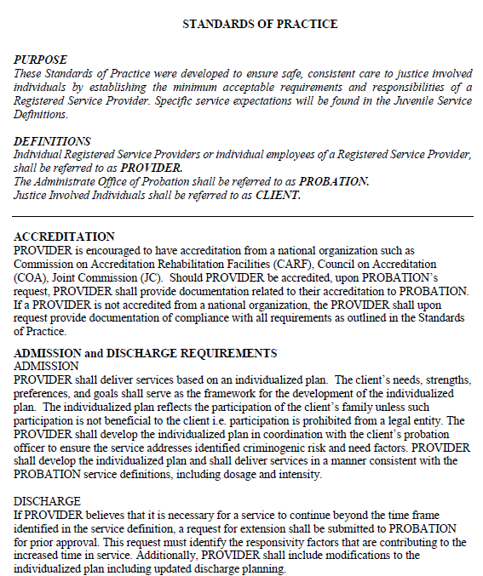
Standards of Practice
Requires all service providers to follow
Hold provider accountable
Have a document to refer to when situations arise with our providers
Notes:
Say: Now we will discuss what Standards of Practices are.

Slide 36
Communication
Share information
Ask questions
Collateral information
Recommendations
Notes:
We communicate for a variety of reasons! We use communication to share information, comment, ask questions, express wants and needs, develop social relationships, social etiquette, etc. Communication is much more than wants and needs. Our main reasons for communication change over time just slightly
Say: if there are concerns with relationship with provider
Talk to provider
Talk to district supervisor
Follow your district process
Talk to service provider network manager
Say: How do you talk to providers about services?
Work with provider --- use your in district process—the districts have the relationship with the providers so if there are concerns or questions use the established relationship you already have---the relationship is key to maintaining services
Consult with supervisor if you have questions that you can not answer ---staff the case
If there are still questions please contact your service provider network manager
If a provider complains that they can not see things in NPACS it may be true –just give them the information they need to implement the services.
.

