Slide 1
Riding the Wave: Living Your Life with Difficult Emotions. A DBT Perspective
Kristen Galloway, Ph.D.

Slide 2
No commercial support is being provided for this continuing education activity.

Slide 3
Objectives
Demonstrate and apply the DBT framework with clients with substance use concerns.
Describe emotion regulation within the DBT framework.
Choose and implement skills that promote emotion regulation in your clients.
Maximizing treatment to promote a more emotionally regulated lifestyle.
Demonstrate knowledge of how to use emotion regulation techniques as prevention.

Slide 4
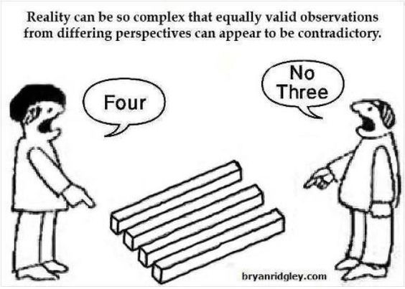

Slide 6
What does Dialectical Mean?
Two opposite ideas can be true at the same time.
There is more than one way to think about/look at a situation.
All people have something different to offer.
Life has both positive (happiness) and negative aspects (sadness, anger) AND all of these aspects are necessary and valuable.

Slide 7
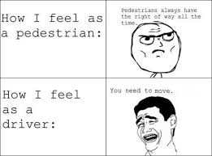
Why are Dialectics Helpful?
A dialectic orientation leads to:
Fewer extremes in emotions, thinking & behavior
Keeping “unstuck”
Validation of self and others
Resolution of conflict
Understanding context

Slide 8
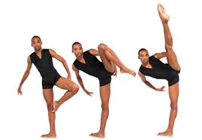
How are dialectics helpful in substance use?

Slide 9
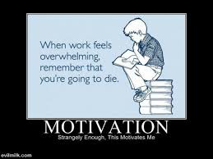
Core DBT Assumptions
People are doing the best they can in the moment AND they need to do better.
People cannot fail.
People want to AND need to improve.
Skills can be generalized to all relevant areas of life.

Slide 10
It’s a Balancing Act
Acceptance
Change
Problem Solving
Validation
Dialectic

Slide 11
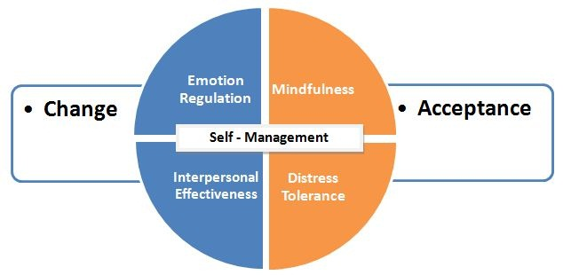
DBT Skill Areas

Slide 12
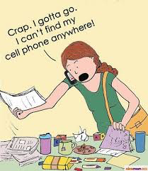
When are DBT skills useful
Emotional/Self-Regulation
Anger management
Interpersonal conflict
Self-esteem/ Self Identity
Behavioral Regulation
Self-harm behaviors
Impulsive behaviors
Cognitive Distortions
Substance Use

Slide 13
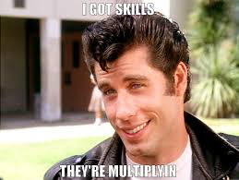
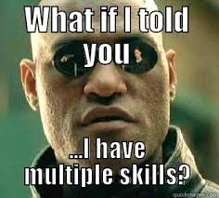
I got skills…
Emotional regulation skills

Slide 14
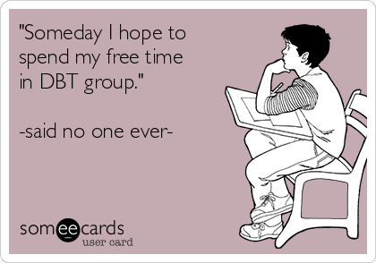
Emotion Regulation

Slide 15
Goals of Emotion Regulation
Better understanding of emotions
Prevent emotional extremes/suffering
Learn to live a balanced lifestyle
Develop skills to problem solve when in an emotional situation
Produce more EFFECTIVE mood congruent behavior

Slide 16
Why Bother?
Emotions happen ALL THE TIME.
Poor emotional control can lead to poor choices/outcomes.
In the long term, poor choices tend to intensify painful emotions.
Emotions give information
Emotions communicate to and influence others
Motivate and prepare for action

Slide 17
Pros and Cons of Changing Emotions
PROS | Acting Impulsively, stay in emotion | Regulate emotion
CONS | Acting Impulsively, stay in emotion | Regulate emotion

Slide 18
DBT Model of Emotions
Event
Interpretation/
Thoughts
Result
Action
Feeling
Action Urge

Slide 19
DBT Model of Emotions: Example
Argument
Relationship strain
“Nothing is going to change”
Disappointment
Hopeless/Hurt
Substance use
Withdraw

Slide 20
Emotion Regulation skills
Identifying and Labeling Emotions
ABC PLEASE
Coping Ahead
Check the Facts
Riding the Wave
Opposite to Emotion Action

Slide 21
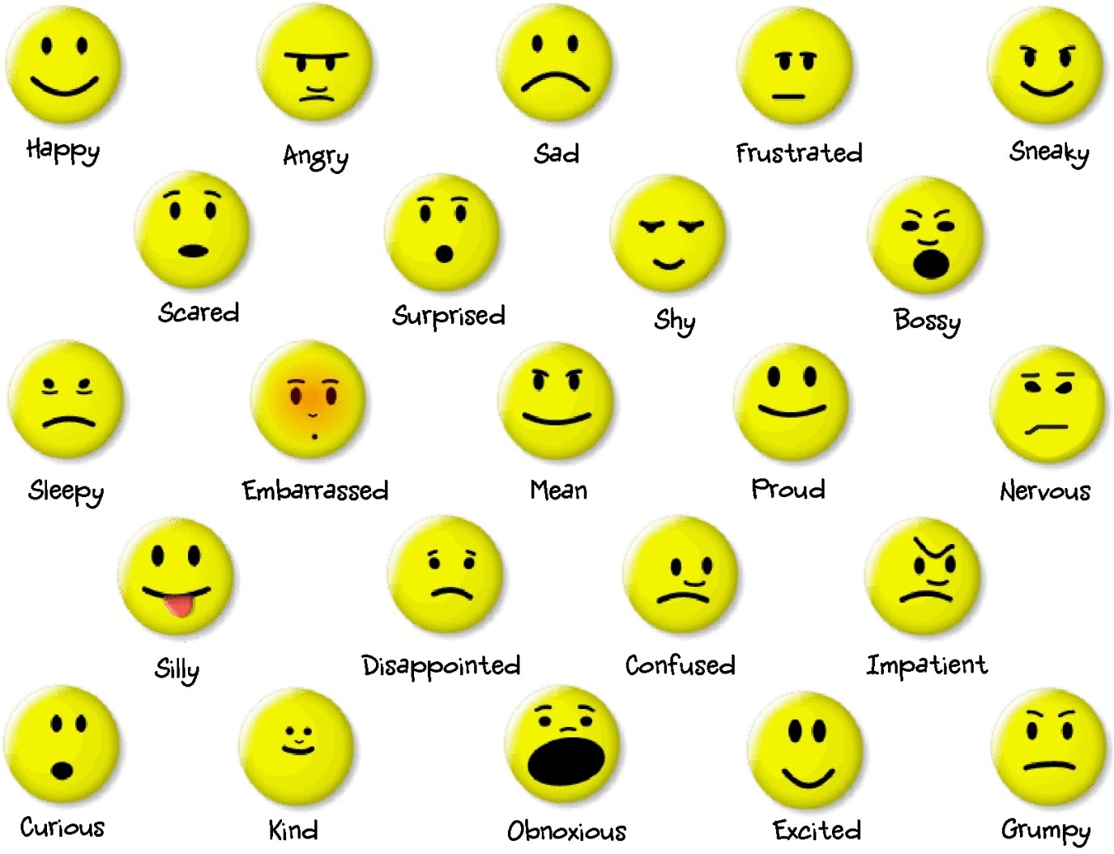
Identifying and Labeling Emotions

Slide 22
Identifying and Labeling Emotions: substance use
Label own emotions
Model and describe physiological cues associated with the emotion
Identify urges related to emotion and how that differs from their reaction
Use “I feel” statements
Sit with an emotion without reacting
Communicate emotions to others

Slide 23
ABC PLEASE

Slide 24
ABC PLEASE
Accumulate Positive Experiences – Short Term
Building Mastery/Positive Experiences – Long Term
Coping Ahead
PhysicaL Health
Eat 3 healthy meals – balanced
Avoid mood-altering drugs
Sleep between 8-10 hrs daily
Exercise daily

Slide 25
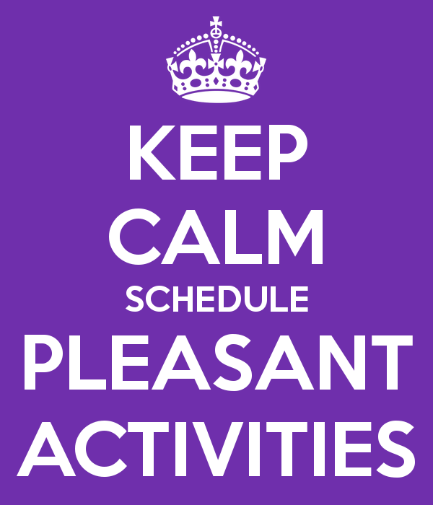
Accumulate Positive Experiences – Short Term

Slide 26
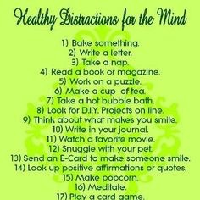
Accumulate Positive Experiences – Short Term:
Make a list
Set a daily goal
Schedule time
Problem solve barriers
BUILDING MASTERY

Slide 27
Building Positive Experiences – Long Term

Slide 28
Building Positive Experiences – Long Term: Example
Increase discussion about values
Identify and write down a value that is important
Identify long-term goals based on the value
Select one of the long-term goals
Brainstorm initial steps that could take you toward the goal
Identify and select a first step

Slide 29
Coping ahead of time with emotions
Describe an upcoming situation that is likely to create negative emotions
Decide which skills you want to use in the situation
Imagine the situation in your mind as vividly as possible
Rehearse coping effectively in your mind

Slide 30
Coping Ahead: Substance Use

Slide 31
PLEASE
PhysicaL Health
Eat 3 healthy meals – balanced
Avoid mood-altering drugs
Sleep between 8-10 hrs daily
Exercise daily

Slide 32
PLEASE: Substance Use
How does your treatment support these goals?
What are some barriers with substance users?

Slide 33
Opposite-to-emotion action
Break ineffective emotional cycles by acting opposite to behaviors that are mood congruent
Opposite action may also create a different emotion
When to Use:
Intense emotions
Long-lasting emotion
Acting on emotion will be ineffective

Slide 34
Opposite Action: example
Figure out emotion you are feeling.
What is the action URGE that comes with the emotion?
Does the emotion fit the facts?
Do I want to change the emotion?
If yes, figure out the opposite action
Do the opposite action – ALL THE WAY.
Repeat opposite action until emotion goes down enough for you to notice.

Slide 35
Questions!

Slide 36
References
Christensen, K.; Riddoch, G.N.; & Huber, J. (2009). Dialectical Behavior Therapy Skills, 101 Mindfulness Exercises, and Other Fun Activities for Children and Adolescents: A learning supplement. New Bloominton, Indiana: AuthorHouse.
Linehan, M. (1993, 2007). Skills Training Manual for Treating Borderline Personality Disorder. New York: Guilford Press.
Linehan, M. (2015). DBT skills training manual (2nd ed.). New York: Guilford Press.
McKay, M.; Wood, H.; & Brantley, J. (2007). The Dialectical Behavior Therapy Skills Workbook: Practical DBT Exercises for Learning Mindfulness, Interpersonal Effectiveness, Emotion Regulation, and Distress Tolerance. Oakland, California: New Harbinger Publications, Inc.
Rathus, J.H. & Miller, A.L. (2015) DBT Skills Manual for Adolescents. New York: Guilford Press.
Behavioraltech.org

